Slide 1


Brand Guidelines

Slide 2

Brand Promise

Slide 3

Brand Promise – Tone of Voice (Internal)
A brand is more than a name, slogan, or logo. Our brand is a promise. A promise that each time someone interacts with Catalyst Health Network, our brand will stand for certain values and priorities. As members of Catalyst Health Network, we are the keepers of our brand promise. We strive to deliver it at every point of contact with our clients, including our services, phone calls, customer service, website and marketing efforts. It is critical that each of us understand the nature of our promise and how our individual performance delivers that promise.
TONE OF VOICE These core attributes work together to create a distinct tone, which we express through language and style: PURPOSE – Our highest calling Transforming the health and well-being of communities through the power of relationships. POSITION – How we think about our brand For those seeking better value from their healthcare experience, Catalyst Health Network empowers the physician/patient relationship by understanding and responding to the needs of those we serve. PERSONALITY– Characteristics of our brand Bold – Action Oriented – Innovative – Empathetic - Collaborative PERSONA – How brand users view us For those striving to make a difference in people’s lives.
Reviving the Heart of Healthcare
Notes:
Add correct brand strategy

Slide 4


Brand Promise
Healthier Practices
Healthier Physicians
Healthier Patients
Reviving the Heart of Healthcare
Notes:
Add correct brand strategy

Slide 5
Brand Promise – Messaging
ABOUT US
Catalyst Health Network is a URAC Accredited Clinically Integrated Network of independent primary care physicians who have come together to provide coordinated, high-quality care to our patients. Catalyst Health Network operates as a non-profit organization improving health, coordinating care, and lowering cost – creating sustainable and predictable value. The network is comprised solely of physician members and managed by StratiFi Health, a physician services and population health organization.
TAGLINE – Usually appears in Ubuntu font
Reviving the Heart of Healthcare
APPROVED MESSAGES – Usually appears in Ubuntu font
Reviving the Heart of Healthcare
The Catalyst Difference
Trailblazing a Path in North Texas
Powering Wellness
The Future of Care in North Texas
Created by Physicians, for Physicians
5th URAC Accredited Clinically Integrated Network in the Nation
Reviving the Heart of Healthcare

Slide 6
Logos

Slide 7
Logo – Approved Usage
The Catalyst Health Network logo is the heart of our identity. It is how the community identifies us and our commitment to Reviving the Heart of Healthcare. It is imperative that we use it correctly everywhere it appears.
FULL COLOR
WHITE
Reviving the Heart of Healthcare

Slide 8
Logo – Misuse
To preserve the integrity of our brand, we must use our signature logo and consistently in every application. Altering, distorting or redrawing the logo in any way weakens the power of the image and what it represents.
Do not change the colors
Logo should never appear in all black
Do not add a border around the logo
Do not stretch/distort the logo
Logo should never be one color
(when not white)
Logo should never appear
without the mark
Never use Catalyst without “Health Network”
Reviving the Heart of Healthcare
Notes:
ALL CHN Black option

Slide 9

Logo – Background Usage
To preserve the integrity of our brand, we must use our signature logo and consistently in every application. Altering, distorting or redrawing the logo in any way weakens the power of the image and what it represents.
Never place a logo on BACKGROUND USAGE:
a background that matches a color in the logomark. Never place the full color logo on black background.
Content Boxes Red/Amber Gradient
Content Boxes Dark & Medium Teal Gradient
Photo Overlay Red/Amber Gradient
Photo Overlay Dark & Medium Teal Gradient
Full Color
Black Background
Reviving the Heart of Healthcare

Slide 10
Logo – Spacing
PROPER SPACING
PROPER SPACING:
Sufficient spacing around the logo allows the design to stand out, remain uncluttered, and helps to establish hierarchy. This rule also applies when the logo is in front of a bar of color.
The spacing around the Catalyst Health Network logo is determined by the font’s x-height, or the corpus size, is the distance between the baseline and the mean line of the lower-case letters in a typeface.
1.50x
1.50x
1.50x
1.50x
MINIMUM SIZE:
The minimum width of the Catalyst Health Network logo should always be greater than 1.50 in or 37.84 mm. This ensures that the wordmark remains highly visible and easy to read.
1x
1x
1x
1x
MINIMUM SIZE
1.50in
1.50in
1.50in
.63” in
.63” in
.63” in
Reviving the Heart of Healthcare
Notes:
Black background option

Slide 11
Logo – Member of Catalyst Health Network
Members of Catalyst Health Network can use the Member logo when displaying membership with Catalyst Health Network.
Member of
Reviving the Heart of Healthcare

Slide 12
Typography

Slide 13
Typography – Primary Fonts
PRIMARY FONT
Source Sans Pro is our primary typeface and should be used for all communications. This typeface is available for download on SharePoint in TrueType format (TTF). Suggested font size is 11.
ATTENTIVE FONT
Ubuntu is our attentive typeface and should be used for all communications. This typeface is available for download on SharePoint in TrueType format (TTF). Ubuntu is only used for headers, subheaders, and footers and usually Bold.
ATTENTIVE FONT
Ubuntu
Ubuntu Regular
Ubuntu Regular Italic
Ubuntu Bold
Ubuntu Bold Italic
PRIMARY FONT Source Sans Pro Source Sans Regular Source Sans Regular Italic Source Sans Bold Source Sans Bold Italic
BODY
ATTENTION / CALL OUTS
FOOTERS
HEADERS
SUBHEADERS
Ubuntu should never be in italic, CAPS, or Light version. The preferred font type is regular.
REVIVING THE HEART OF HEALTHCARE
REVIVING THE HEART OF HEALTHCARE
Reviving the Heart of Healthcare
Notes:
Make similar to SFH

Slide 14
Typography – Secondary Fonts
Calibri (Body) is our secondary typeface and the preferred font for all email communications. Use it when Source Sans Pro is not available.
SECONDARY FONT
 | Calibri (Body) Calibri (Body) Regular Calibri (Body) Regular Italic Calibri (Body) Bold Calibri (Body) Bold Italic
BODY
HEADERS
SUBHEADERS
Reviving the Heart of Healthcare

Slide 15
Color
Palette

Slide 16
Colors – Solids
PRIMARY
GREY COLORS
#E74F29
#FF9505
#353531
#7E7E7B
#F6F6F6
#FFFFFF
C: 4%
M: 84%
Y: 98%
K: 0%
R: 255
G: 149
B: 5
C: 0%
M: 50%
Y: 100%
K: 0%
R: 231
G: 79
B: 41
C: 2%
M: 2%
Y: 2%
K: %
R: 255
G: 255
B: 255
C: 0%
M: 0%
Y: 0%
K: 0%
C: 52%
M: 43%
Y: 46%
K: 9%
R: 246
G: 246
B: 246
C: 68%
M: 61%
Y: 65%
K: 58%
R: 126
G: 126
B: 123
R: 53
G: 53
B: 49
SECONDARY
RGB: (Red, Green, Blue) color model in which red, green, blue light are added together in various ways to reproduce a broad array of colors. Mostly used for web design and often represented with a hexadecimal value that browsers can read.
HEX CODES: Hexadecimal color values are used when displaying web pages and HTML, they are displayed with a # and represent RGB color values.
CMYK: (Cyan, Magenta, Yellow, Key Black) referred to a process color, full color or four color. A color model used in full color printing. Most colors can be created using these four colors.
PANTONE: (Pantone Matching System PMS) is a proprietary color space used in a variety of industries, primarily printing. Colors are like paint swatches – each has its own custom makeup always appears consistently. They are used for a more controlled and consistent print job.
#C4300B
#F58753
#FFC70C
#19535F
C: 89%
M: 55%
Y: 49%
K: 28%
R: 196
G: 48
B: 11
C: 16%
M: 94%
Y: 100%
K: 0%
R: 245
G: 135
B: 83
C: 0%
M: 58%
Y: 73%
K: 0%
R: 255
G: 199
B: 12
C: 0%
M: 22%
Y: 98%
K: 00%
R: 27
G: 84
B: 95
#368B98
#05A8AA
#0CD3D5
C: 78%
M: 31%
Y: 36%
K: 03%
R: 5
G: 168
B: 170
C: 78%
M: 11%
Y: 37%
K: 0%
R: 12
G: 211
B: 213
C: 64%
M: 0%
Y: 24%
K: 0%
R: 54
G: 139
B: 152
Reviving the Heart of Healthcare

Slide 17
Color – Gradients
PRIMARY GRADIENTS
The primary gradient colors must be only used in photo overlays or as content boxes - posters, word documents, flyers, etc.
SECONDARY GRADIENTS
These secondary gradient colors must be used as icons only.
Catalyst Dark Red/Amber Gradient
Catalyst Dark/Medium Teal Gradient
Catalyst Red/Light Orange Gradient
Catalyst Medium/Light Teal Gradient
Catalyst Medium/Light Amber Gradient
#C4300B
#19535F
#E74F29
#368B98
#FF9505
R: 196
G: 48
B: 11
C: 16%
M: 94%
Y: 100%
K: 00%
R: 27
G: 84
B: 95
C: 89%
M: 55%
Y: 49%
K: 28%
R: 231
G: 79
B: 41
C: 04%
M: 84%
Y: 98%
K: 00%
R: 231
G: 79
B: 41
C: 78%
M: 31%
Y: 36%
K: 03%
R: 255
G: 149
B: 5
C: 0%
M: 50%
Y: 100%
K: 00%
#FF9505
#368B98
#F58753
#0CD3D5
#FFC70C
R: 255
G: 149
B: 5
C: 00%
M: 58%
Y: 73%
K: 00%
R: 54
G: 139
B: 152
C: 78%
M: 31%
Y: 36%
K: 03%
R: 245
G: 135
B: 83
C: 00%
M: 58%
Y: 73%
K: 00%
R: 12
G: 211
B: 213
C: 64%
M: 0%
Y: 24%
K: 00%
R: 255
G: 199
B: 12
C: 00%
M: 22%
Y: 98%
K: 00%
Reviving the Heart of Healthcare

Slide 18
Colors – Cheat Sheet
(P): Primary | (S): Secondary | (G): The Greys
WHEN TO USE RGB, CMYK, PANTONES, HEX CODES
RGB: Red, Green, Blue) color model in which red, green, blue light are added together in various ways to reproduce a broad array of colors. Mostly used for web design and often represented with a hexadecimal value that browsers can read. CMYK: (Cyan, Magenta, Yellow, Key Black) referred to a process color, full color or four color. A color model used in full color printing. Most colors can be created using these four colors. PANTONES: (Pantone Matching System PMS) is a proprietary color space used in a variety of industries, primarily printing. Colors are like paint swatches – each has its own custom makeup always appears consistently. They are used for a more controlled and consistent print job. HEX CODES: Hexadecimal color values are used when displaying web pages and HTML, they are displayed with a # and represent RGB color values.
 | RGB | CMYK | Pantone | Hex Code
(P) Catalyst Dark Orange | R: 35 G: 177 B: 165 | C: 74% M: 05% Y: 42% K: 00% | Orange 021 C | #e74f29
(P) Catalyst Light Orange | R: 19 G: 132 B: 188 | C: 82% M: 39% Y: 07% K: 00% | 1375 C | #ff905
(S) Catalyst Red | R: 193 G: 215 B: 45 | C: 29% M: 00% Y: 100% K: 00% | 7626 C | #c4300b
(S) Catalyst Faded Orange | R: 16 G: 132 B: 124 | C: 85% M: 29% Y: 54% K: 08% | 164 C | #f58753
(S) Catalyst Yellow | R: 53 G: 133 B: 85 | C: 80% M: 26% Y: 82% K: 10% | 7548 C | #ffc70c
(S) Catalyst Dark Teal | R: 163 G: 106 B: 30 | C: 30% M: 58% Y: 100% K: 15% | 2182 C | #19535f
(S) Catalyst Medium Teal | R: 54 G: 149 B: 152 | C: 11% M: 53% Y: 100% K: 01% | 5483 C | #368b98
(S) Catalyst Light Medium Teal | R: 250 G: 167 B: 25 | C: 00% M: 39% Y: 100% K: 00% | 326 C | #05a8aa
(S) Catalyst Turquoise | R: 246 G: 235 B: 38 | C: 07% M: 00% Y: 94% K: 00% | 3252 C | #0cd3d5
(G) Catalyst Dark Grey | R: 126 G: 126 B: 123 | C: 52% M: 43% Y: 46% K: 09% | Cool Gray 8 C | #7e7e7b
(G) Catalyst Black | R: 53 G: 53 B: 49 | C: 68% M: 61% Y: 65% K: 58% | 447 C | #353531
(G) Catalyst Light Grey | R: 246 G: 246 B: 246 | C: 02% M: 02% Y: 02% K: 02% | none | #f6f6f6
(G) Catalyst White | R: 255 G: 255 B: 255 | C: 00% M:00% Y: 00% K: 00% | none | #ffffff
Reviving the Heart of Healthcare

Slide 19
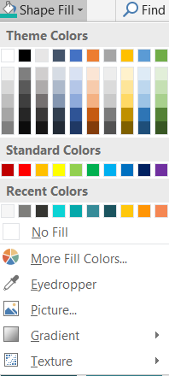
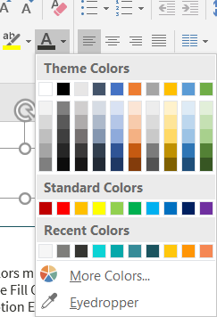
Colors – Eyedropper Tool For PowerPoint
PRIMARY
All primary colors must be in RGB for PowerPoint
Take the Shape Fill Color, Shape Outline, Text Color, etc. and
Choose the option Eyedropper.
Click on the specific color that you want to choose as the primary color.
SECONDARY
All secondary colors must be in RGB for PowerPoint
Take the Shape Fill Color, Shape Outline, Text Color, etc. and
Choose the option Eyedropper.
Click on the specific color that you want to choose as the secondary color.
GREY COLORS
All the greys colors must be in RGB for PowerPoint
Take the Shape Fill Color, Shape Outline, Text Color, etc. and
Choose the option Eyedropper.
Click on the specific color that you want to choose as the primary color.
Disclaimer:
Do not add any other colors to this palette and in any other documents and collateral items.
Reviving the Heart of Healthcare

Slide 20
Icons

Slide 21
Icons
Use these icons to represent Catalyst Health Network. They should only appear with color gradients, and not with solid colors. If additional icons are needed, notify marketing department.
Catalyst Red/Light Orange Gradient
Catalyst Medium/Light Teal Gradient
Catalyst Medium/Light Amber Gradient
Reviving the Heart of Healthcare

Slide 22
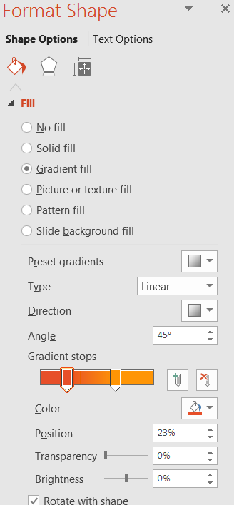
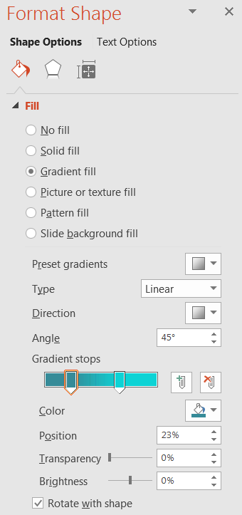
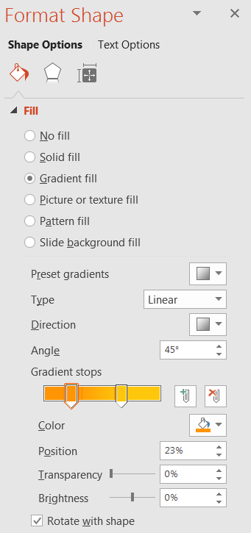

Icons – Usage
These icons are made to be used for PowerPoints and Word Documents. They are in.svg format where you can easily edit and copy + paste to the standards of the chronological order in your documents, flyers.
Reviving the Heart of Healthcare

Slide 23
Photography

Slide 24




Photography – Usage
The Catalyst Health Network photography style isn’t staged; it’s uniquely angled to capture today’s customers and show how Catalyst Health Network benefits them every day. It should be influenced by the latest in the healthcare industry. You may download the following photos in SharePoint.
Welcoming, age range present, less authoritative outfits
Fresh, clean colors and inviting, smiles and laughter bring warmth
Strong, teamwork, statement message
Warm colors, smiles, age range present, yellows present
Photography Quick Tips:
Apply Photoshop filter “hue/exposure/ brightness” to lighten photo between 10-15%, make sure it doesn’t wash out color, then raise the “saturation/temperature” level between 20-35% to obtain desired warmth and color. Yellow, golden and blue undertones or light streaks help our messaging come across as warm, inviting and fresh.
Be sure logo is always visible when placed on photography. The logo design may clash with pockets of heavy color, so keep that in mind when considering logo placement.
Reviving the Heart of Healthcare

Slide 25



Photography – Misuse
The Catalyst Health Network photography style isn’t staged; it’s uniquely angled to capture today’s customers and show how Catalyst Health Network benefits them every day. It should be influenced by the latest in the healthcare industry.
Staged Photos
Boring/Staged Photos
Vague Photos
Wrong use of color overlay
STAY AWAY FROM FROM:
Staged photos
Boring and staged photos
Vague photos
Wrong use of color overlay
Reviving the Heart of Healthcare

Slide 26

Photography – Overlay
The Catalyst Health Network photo overlays have two options - red/orange gradient and dark/medium teal gradient.
Reviving the Heart of Healthcare
Reviving the Heart of Healthcare

Slide 27
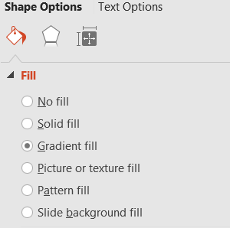
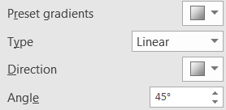
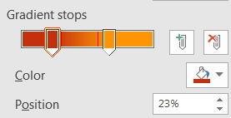
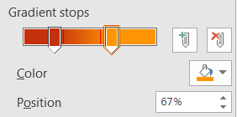
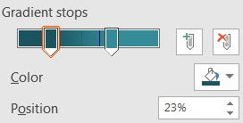
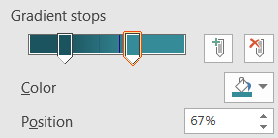

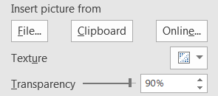
Photography Overlay - Gradient Usage
The Catalyst Health Network photo overlays have two options - red/orange gradient and dark/medium teal gradient.
Catalyst Health Network Style Guide PPT version
Reviving the Heart of Healthcare

Slide 28
Corporate Identity

Slide 29
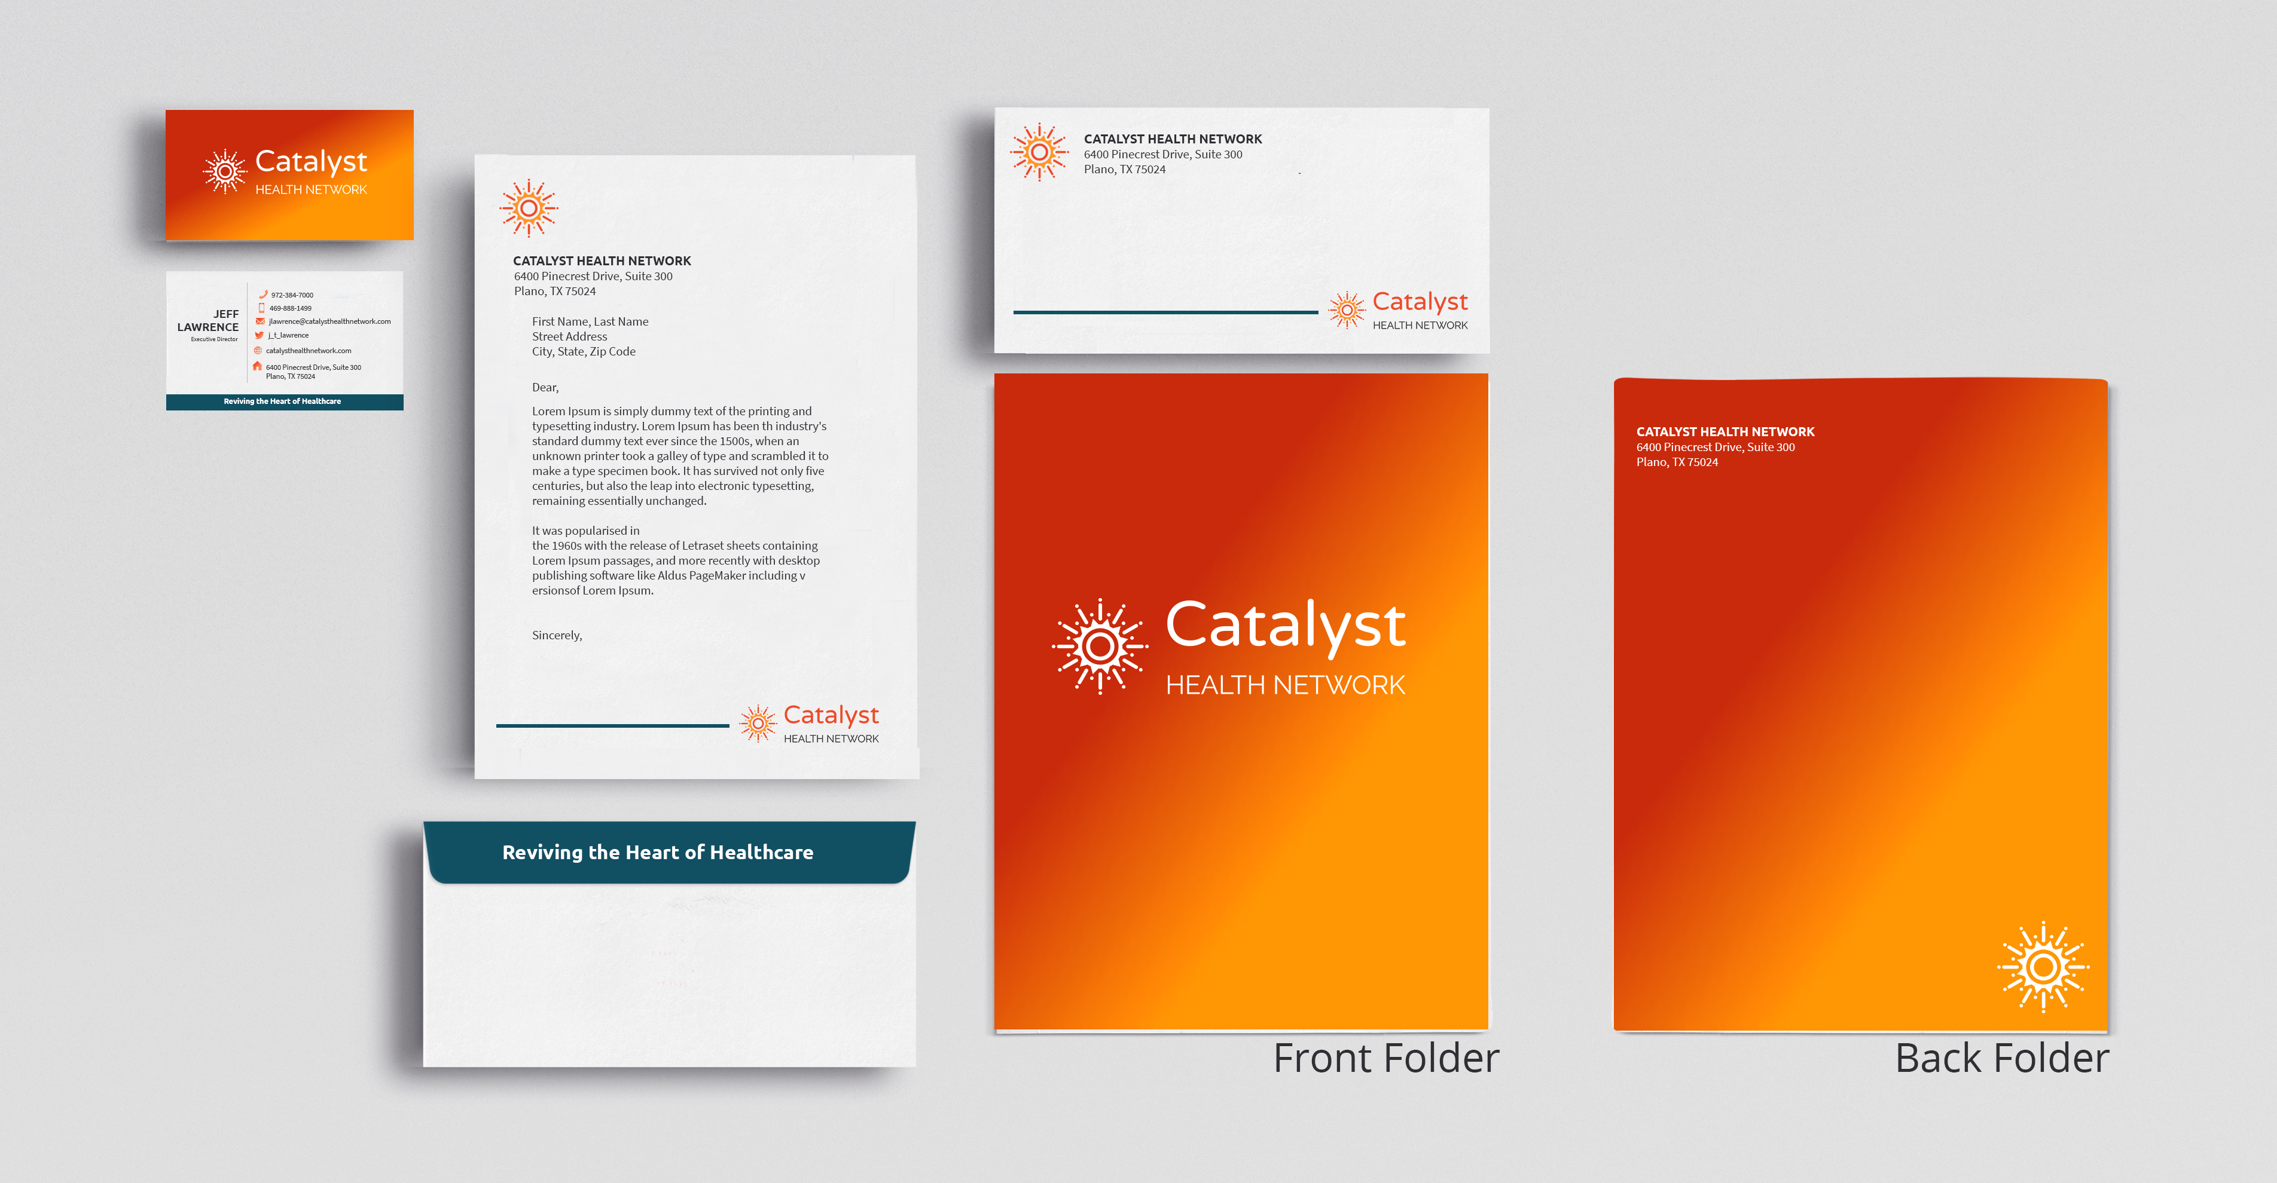
Corporate Identity – Stationery
The Catalyst Health Network’s corporate document templates can be downloaded on SharePoint. A sample is below.
Reviving the Heart of Healthcare

Slide 30

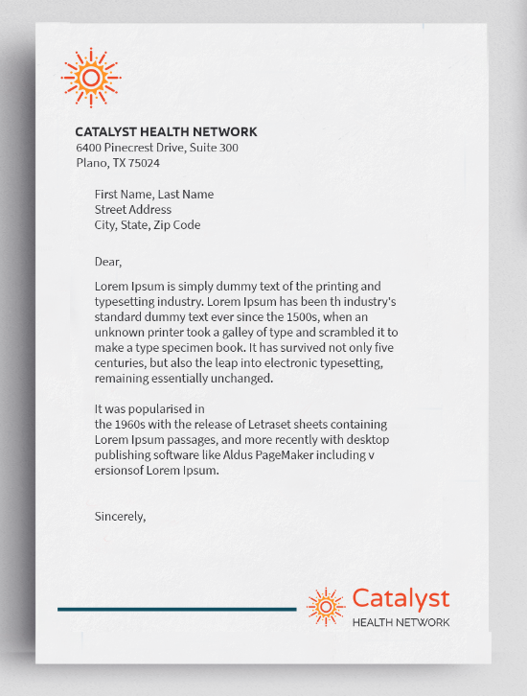
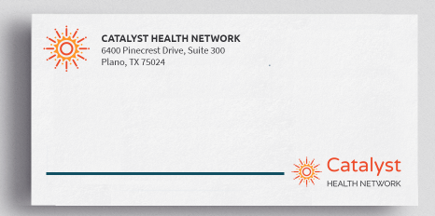
Logo – Mark Usage
Only use the mark in stationery envelopes, documents, folders, and letterhead.
Reviving the Heart of Healthcare

Slide 31

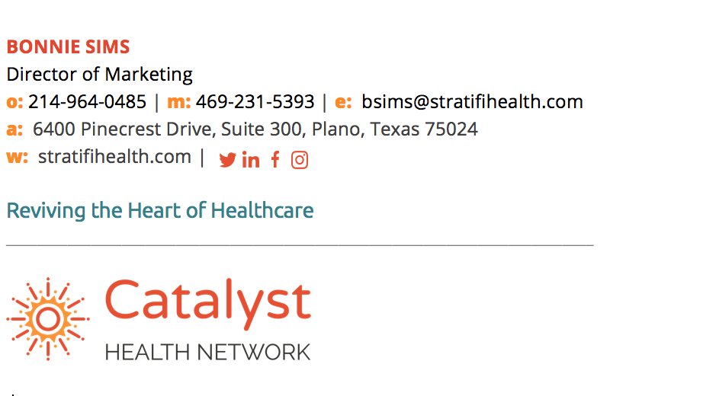
Email Signature
Reviving the Heart of Healthcare

Slide 32
Action Items
Identify department brand ambassador
Start using new templates by Monday, July 2
Add your contact information to the email signature spreadsheet by noon Friday, June 29
Reviving the Heart of Healthcare

Slide 33
Questions
Email us at marketing@catalysthealthnetwork.com

