Slide 1

Brand Guidelines

Slide 2
Brand Promise

Slide 3
Brand Promise – Tone of Voice (Internal)
A brand is more than a name, slogan, or logo. Our brand is a promise. A promise that each time someone interacts with StratiFi Health, our brand will stand for certain values and priorities. As members of StratiFi Health, we are the keepers of our brand promise. We strive to deliver it at every point of contact with our clients, including our services, phone calls, customer service, website and marketing efforts. It is critical that each of us understand the nature of our promise and how our individual performance delivers that promise.
TONE OF VOICE These core attributes work together to create a distinct tone, which we express through language and style: Purpose – Our highest calling Healthcare as it should be. Positioning – How we think about our brand For those who want to spend less time and money navigating the complexities of providing healthcare, StratiFi Health is an integrated solutions partner that empowers you to share your own path and forge deeper connections to those you serve. Personality – Characteristics of our brand Visionary – Passionate – Committed – Principled – Empathetic - Collaborative Persona – How brand users view us For people committed to a better way and willing to challenge the status quo.
Helping Communities Thrive
Notes:
Internal facing communication, used as a guide for all collateral, training, messaging, etc. Large investment for the company – involved a lot of research and stakeholder interviews.

Slide 4
Brand Promise – Core Values
Relationships Matter
Serve Others First
Purpose Driven
Inspire Creativity
Helping Communities Thrive
Notes:
Core Values served as a foundation for our brand identity and we are working to redefine what they mean for us this year

Slide 5
Brand Promise – Messaging
ABOUT US
StratiFi Health exists to improve the health of communities by providing integrated solutions for population health and physician practice services that proactively shape the patient's healthcare experience.
Our unique approach to Population Health is to support and optimize the Physician-Patient relationship, the foundation being Primary Care. Providers are powered with a team-based care approach that guides the patient to ensure they receive the appropriate care in the appropriate setting for all their healthcare needs.
Our physician practice services empower independent practices with insights, tools, and actionable strategy, which is essential for successful transformation and longevity. We enable you to shape your own path and forge deeper connections with your patients while preserving your independence.
TAGLINE – Usually appears in Rock Salt font Helping Communities Thrive
APPROVED MESSAGES – Usually appears in Rock Salt font Helping Communities Thrive Better Healthcare… Together Healthcare The Way It Should Be Empowering Healthcare Integrated Solutions Partner
Helping Communities Thrive

Slide 6
Logos

Slide 7
Logo – Approved Usage
The StratiFi Health logo is the heart of our identity. It is how the community identifies us and our commitment of Helping Communities Thrive. It is imperative that we use it correctly everywhere it appears.
FULL COLOR
BLACK
WHITE
REVERSE
Helping Communities Thrive

Slide 8




Logo - Misuse
To preserve the integrity of our brand, we must use our logo consistently in every application. Altering, distorting or redrawing the logo in any way weakens the power of the image and what it represents.
Do not change the colors
Do not flip flop the signature logomark
Do not add a border around the logo
Do not stretch/distort the logo
Logo should never be one color (when not black or white)
Logo should never appear without logomark
Never use StratiFi without “HEALTH”
Helping Communities Thrive

Slide 9


Logo – Background Usage
To preserve the integrity of our brand, we must use our logo consistently in every application. Altering, distorting or redrawing the logo in any way weakens the power of the image and what it represents.
BACKGROUND USAGE:
Never place a logo on a background that matches a color in the logomark. Never place the full color logo on a black background.
SFH Navy
SFH Teal
Photo Overlay
White Background
Black Background
Helping Communities Thrive

Slide 10
Logo – Product and Solution Offerings
To preserve the integrity of our brand, we must use our logo consistently for all product and solution offerings. Altering, distorting or redrawing the logo in any way weakens the power of the image and what it represents.
The logo must remain clearly visible and adhere to the usage and standards below for all product and solution offerings. The use of Rock Salt font must be used for product/solution offering and the use of StratiFi Health grey is approved in this instance.
- Population Health -
- Practice Services -
- Pharmacy Solutions -
Helping Communities Thrive

Slide 11

Logo – Spacing
PROPER SPACING:
Sufficient spacing around the logo allows the design to stand out, remain uncluttered, and helps to establish hierarchy. This rule also applies when the logo is in front of a bar of color.
The spacing around the StratiFi Health logo is determined by the font’s x-height, or the corpus size, is the distance between the baseline and the mean line of the lower-case letters in a typeface.
PROPER SPACING
1x
1x
MINIMUM SIZE:
The minimum width of the StratiFi Health logo should always be greater than 1 in or 25.4 mm. This ensures that the wordmark remains highly visible and easy to read.
1x
1x
MINIMUM SIZE
Helping Communities Thrive

Slide 12
Typography

Slide 13
Typography - Primary Fonts
PRIMARY FONT
Open Sans is our primary typeface and should be the primary font used for all communications. This typeface is available for download on SharePoint in TrueType format (TTF). Suggested font size is 11.
ATTENTIVE FONT
Rock Salt is our attentive typeface and should be used for all attentive communications. This typeface is available for download on SharePoint in TrueType format (TTF).
PRIMARY FONT
ATTENTIVE FONT
Open Sans Open Sans Light Open Sans Light Italic Regular Regular Italic Semi Bold Semi Bold Italic Open Sans Bold Open Sans Bold Italic | Rock Salt Rock Salt
ATTENTIVE/ CALL OUTS
FOOTERS
BODY
Rock Salt should never be used in all CAPS or in bold, and should only appear in white, black, or StratiFi Health grey font color.
HEADERS
Helping Communities Thrive
SUBHEADERS
HELPING COMMUNITIES THRIVE
Helping Communities Thrive

Slide 14
Typography - Secondary Font
Calibri (Body) is our secondary typeface and the preferred font for email communication. Use it when Open Sans is not available.
SECONDARY FONT
 | Calibri (Body) Calibri (Body) Regular Calibri (Body) Regular Italic Calibri (Body) Bold Calibri (Body) Bold Italic
BODY
HEADERS
SUBHEADERS
Helping Communities Thrive

Slide 15
Color Palette

Slide 16
Color Palette
PRIMARY COLORS
GREY COLORS
#1384bc
#23b1a5
#c1d72d
#353531
# 7f8084
#dddddd
R: 19
G: 132
B: 188
C: 82%
M: 39%
Y: 7%
K: 0%
R: 35
G: 177
B: 165
C: 74%
M: 5%
Y: 42%
K: 0%
R: 193
G: 215
B: 45
C: 29%
M: 0%
Y: 100%
K: 0%
R: 53
G: 53
B: 49
C: 68%
M: 61%
Y: 65%
K: 58%
R: 127
G: 128
B: 132
C: 53%
M: 44%
Y: 41%
K: 7%
R: 221
G: 221
B: 221
C: 12%
M: 9%
Y: 10%
K: 0%
Pantone: Process Blue C
Pantone: 2401 C
Pantone: 2297 C
Pantone: 447 C
Pantone: 444 C
Pantone: 649 C
RGB: (Red, Green, Blue) color model in which red, green, and blue light are added together in various ways to reproduce a broad array of colors. Mostly used for web design and often represented with a hexadecimal value that browsers can read.
HEX CODES: Hexadecimal color values are used when displaying web pages and HTML, they are displayed with a # and represent RGB color values.
CMYK: (Cyan, Magenta, Yellow, Key Black), referred to as process color, full color, or four color is a color model used in color printing. Most colors can be created using these four colors.
PANTONE: (Pantone Matching System PMS) is a proprietary color space used in a variety of industries, primarily printing. Colors are like paint swatches – each has its own custom makeup always appears consistently. They are used for a more controlled and consistent print job.
SECONDARY COLORS
#20847c
#358555
#a36a1e
#e08913
R: 16
G: 132
B: 124
C: 85%
M: 29%
Y: 54%
K: 8%
R: 53
G: 133
B: 85
C: 80%
M: 26%
Y: 82%
K: 10%
R: 163
G: 106
B: 30
C: 30%
M: 58%
Y: 100%
K: 15%
R: 224
G: 137
B: 19
C: 11%
M: 53%
Y: 100%
K: 1%
Pantone: 322 C
Pantone: 555 C
Pantone: 146 C
Pantone: 144 C
#faa719
#f6eb26
#364f6f
R: 250
G: 167
B: 25
C: 00%
M: 39%
Y: 100%
K: 0%
R: 246
G: 235
B: 38
C: 07%
M: 0%
Y: 94%
K: 0%
R: 54
G: 79
B: 111
C: 86%
M: 68%
Y: 35%
K: 19%
Pantone: 137 C
Pantone: 803 C
Pantone: 534 C
Helping Communities Thrive

Slide 17
Colors – Cheat Sheet
(P): Primary
(S): Secondary
(G): Greys
WHEN TO USE RGB, CMYK, PANTONES, HEX CODES
RGB: (Red, Green, Blue) color model in which red, green, and blue light are added together in various ways to reproduce a broad array of colors. Mostly used for web design and often represented with a hexadecimal value that browsers can read. CMYK: (Cyan, Magenta, Yellow, Key Black), referred to as process color, full color, or four color is a color model used in color printing. Most colors can be created using these four colors. PANTONE: (Pantone Matching System PMS) is a proprietary color space used in a variety of industries, primarily printing. Colors are like paint swatches – each has its own custom makeup always appears consistently. They are used for a more controlled and consistent print job. . HEX CODES: Hexadecimal color values are used when displaying web pages and HTML, they are displayed with a # and represent RGB color values.
 | RGB | CMYK | Pantone | Hex Code
(P) SFH Blue | R: 19 G: 132 B: 188 | C: 82% M: 39% Y: 07% K: 0% | Process Blue C | #1384bc
(P) SFH Teal | R: 35 G: 177 B: 165 | C: 74% M: 05% Y: 42% K: 0% | 2401 C | #23b1a5
(P) SFH Lime | R: 193 G: 215 B: 45 | C: 29% M: 00% Y: 100% K: 0% | 2297 C | #c1d72d
(S) SFH Dark Teal | R: 16 G: 132 B: 124 | C: 85% M: 29% Y: 54% K: 8% | 322 C | #20847c
(S) SFH Dark Green | R: 53 G: 133 B: 85 | C: 80% M: 26% Y: 82% K: 10% | 555 C | #358555
(S) SFH Brown | R: 163 G: 106 B: 30 | C: 30% M: 58% Y: 100% K: 15% | 146 C | #a36a1e
(S) SFH Orange | R: 224 G: 137 B: 19 | C: 11% M: 53% Y: 100% K: 1% | 144 C | #e08913
(S) SFH Light Orange | R: 250 G: 167 B: 25 | C: 0% M: 39% Y: 100% K: 0% | 137 C | #faa719
(S) SFH Navy | R: 54 G: 79 B: 111 | C: 86% M: 68% Y: 35% K: 19% | 534 C | #364f6f
(G) SFH Dark Grey | R: 127 G: 128 B: 132 | C: 53% M: 44% Y: 41% K: 7% | 444 C | #364f6f
(G) SFH Black | R: 53 G: 53 B: 49 | C: 68% M: 61% Y: 65% K: 58% | 447 C | #353531
(G) SFH Light Grey | R: 221 G: 221 B: 221 | C: 12% M: 9% Y: 10% K: 0% | 649 C | #dddddd
(G) SFH White | R: 255 G: 255 B: 255 | C: 00% M:00% Y: 00% K: 00% | none | #ffffff
Helping Communities Thrive

Slide 18
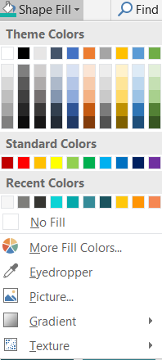
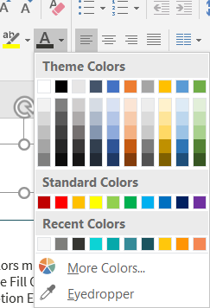
Colors – Eyedropper Tool For PowerPoint
PRIMARY
All primary colors must be in RGB for PowerPoint
Take the Shape Fill Color, Shape Outline, Text Color, etc. and
Choose the option Eyedropper.
Click on the specific color that you want to choose as the primary color.
SECONDARY
All secondary colors must be in RGB for PowerPoint
Take the Shape Fill Color, Shape Outline, Text Color, etc. and
Choose the option Eyedropper.
Click on the specific color that you want to choose as the secondary color.
GREY COLORS
All the greys colors must be in RGB for PowerPoint
Take the Shape Fill Color, Shape Outline, Text Color, etc. and
Choose the option Eyedropper.
Click on the specific color that you want to choose as the primary color.
Disclaimer:
Do not add any other colors to this palette and in any other documents and collateral items.
Helping Communities Thrive

Slide 19
Icons

Slide 20




































Icons – Usage
Use these icons to represent StratiFi Health. You can use these icons in primary, secondary, and the grey colors when it necessary.
SFH Blue
SFH Teal
SFH Lime
SFH Dark Teal
SFH Dark Green
SFH Brown
SFH Dark Orange
SFH Light Orange
SFH Light Navy
Helping Communities Thrive

Slide 21
Photography

Slide 22



Photography Usage
The StratiFi Health photography style is not staged; it is uniquely angled to capture today’s customers and show how StratiFi Health helps communities thrive. It should be warm, inviting, and friendly. You may download the following photos in SharePoint.
Looking At The Camera, Different Ages
Friendly, Bright Smiles
Warmth, Light Flare
Inviting Family Fun, Generational
PHOTOGRAPHY QUICK TIPS:
Apply Photoshop filter “hue/exposure/brightness” to lighten photo between 10-15%, make sure it does not wash out color, then raise the “saturation/temperature” level between 20-35% to obtain desired warmth and color. Yellow, golden and green undertones or light streaks help our messaging come across as warm and inviting.
Be sure logo is always visible when placed on photography. The logo design may clash with pockets of heavy color, so keep that in mind when considering logo placement.
Helping Communities Thrive

Slide 23




Photography Misuse
The StratiFi Health photography style is not staged; it is uniquely angled to capture today’s customers and show how StratiFi Health helps communities thrive. It should be warm, inviting, and friendly. Do not use images that are staged, vague, boring or have strong color overlays.
Helping Communities Thrive
Staged Photos
Strong Color Overlays
Vague Photos
Staged/Boring Photos
STAY AWAY FROM FROM:
Staged photos
Strong color overlays
Vague photos
Boring photos
Helping Communities Thrive

Slide 24
Photography Overlay
The StratiFi Health overlay should have an overlay at 60% transparency with the color shaped overlay of R: 53, G: 53, B:49 (#353531). Use white text only when adding content.
Better Healthcare…Together
Helping Communities Thrive

Slide 25
Corporate Identity

Slide 26

Corporate Identity– Stationery
The StratiFi Health’s corporate document templates can be downloaded on SharePoint. A sample on SharePoint is below.
Helping Communities Thrive

Slide 27
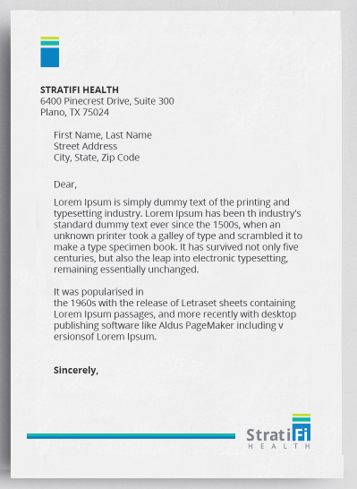

Logo – Use of Mark
Only use the Mark in stationery envelopes and letterhead.
Helping Communities Thrive

Slide 28
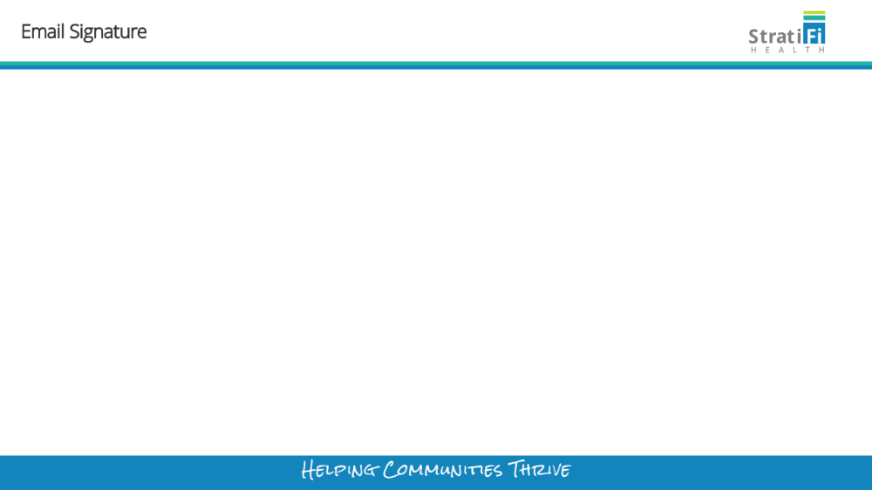
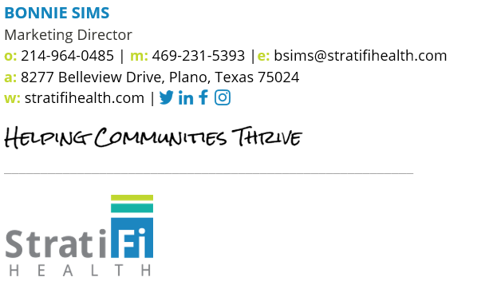
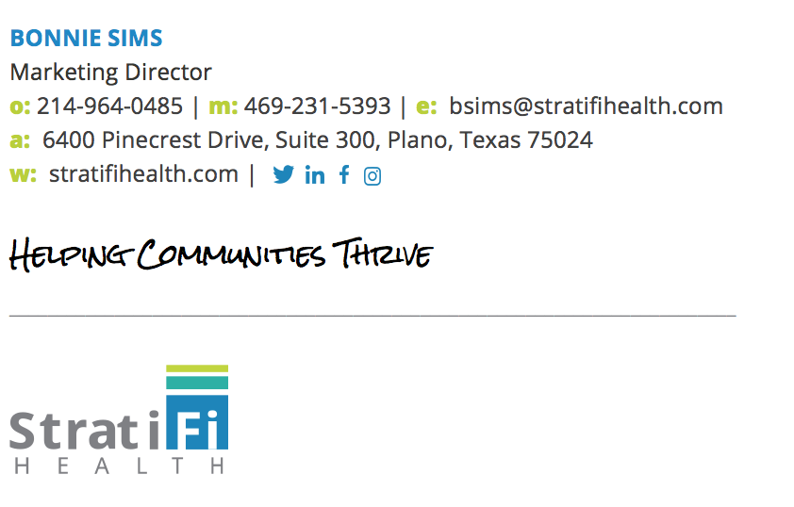
Email Signature
Helping Communities Thrive

Slide 29
Action Items
Identify department brand ambassador
Start using new templates by Monday, July 2
Add your contact information to the email signature spreadsheet by noon Friday, June 29
Helping Communities Thrive

Slide 30
Questions
Email us at marketing@stratifihealth.com

